Slide 1
Fourier Series and Fourier Transforms
Definition of periodic function, Fourier expansion of periodic functions in a given interval of length 2, Determination of Fourier coefficients – Fourier series of even and odd functions, Fourier integral theorem

Slide 2
Fourier transform
The Fourier transform is a type of mathematical function that splits a waveform, which is a time function, into the type of frequencies that it is made of.
A function’s Fourier transform is a complex-valued function denoting the complex sinusoids that contain the original function.
For every frequency, the magnitude of the complex value denotes the constituent complex sinusoid’s amplitude with that frequency, and the complex value’s argument denotes the phase offset of the complex sinusoid

Slide 3
Properties of Fourier transform
The important properties of Fourier transform are –
Duality
Linear transform
Modulation property
Parseval’s theorem

Slide 4
Fourier series
A Fourier series is a precise expansion of periodic functions f(x) in terms of infinite sums of cosines and sines. This series utilises the orthogonality connection of the cosine and sine functions.

Slide 5
Main purpose of the Fourier series
The Fourier series is primarily used to represent a periodic signal in the form of cosine and sine waves. Specifically, it enables us to model any arbitrary periodic signal with a union of cosines and sines.

Slide 6
Primary types of Fourier series
The two primary types of Fourier series are exponential series and trigonometric series.

Slide 7
Steps to solve a Fourier series
The steps which are required for solving a Fourier series are as follows:
Multiply the function by cosine or sine and then integrate it.
Take n = 0, n = 1, n = 2, etc. to calculate the value of coefficients.
In the end, add all the respective coefficients in the Fourier formula.

Slide 8

Periodic Function
A function is periodic of period L if f(x+L) = f(x) for all x in the domain of f. The smallest positive value of L is called the fundamental period.
The trigonometric functions sin x and cos x are examples of periodic functions with fundamental period 2π and tan x is periodic with fundamental period π. A constant function is a periodic function with arbitrary period L.
It is easy to verify that if the functions f1, . . . , fn are periodic of period L, then any linear combination
is also periodic

Slide 9
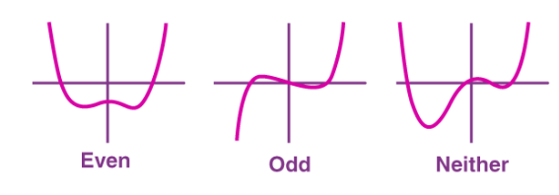
Even and Odd Function
A function f(x) is said to be even if f(−x) = f(x).
The function f(x) is said to be odd if f(−x) = −f(x).
Graphically, even functions have symmetry about the y-axis, whereas odd functions have symmetry around the origin.

